Slide 1
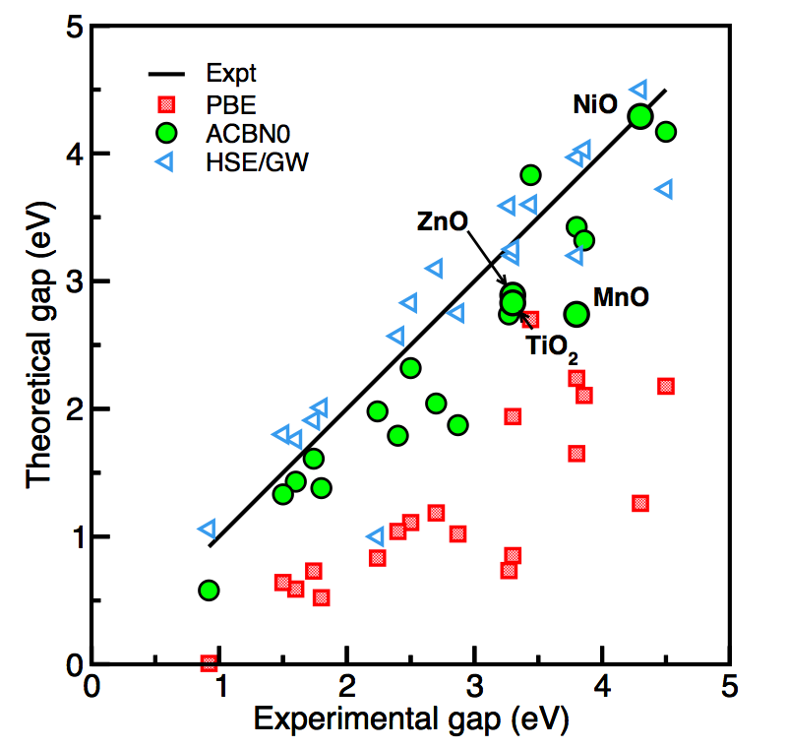
AFRL materials genomics workshop An introduction to local exchange functionals and ACBN0

Slide 2
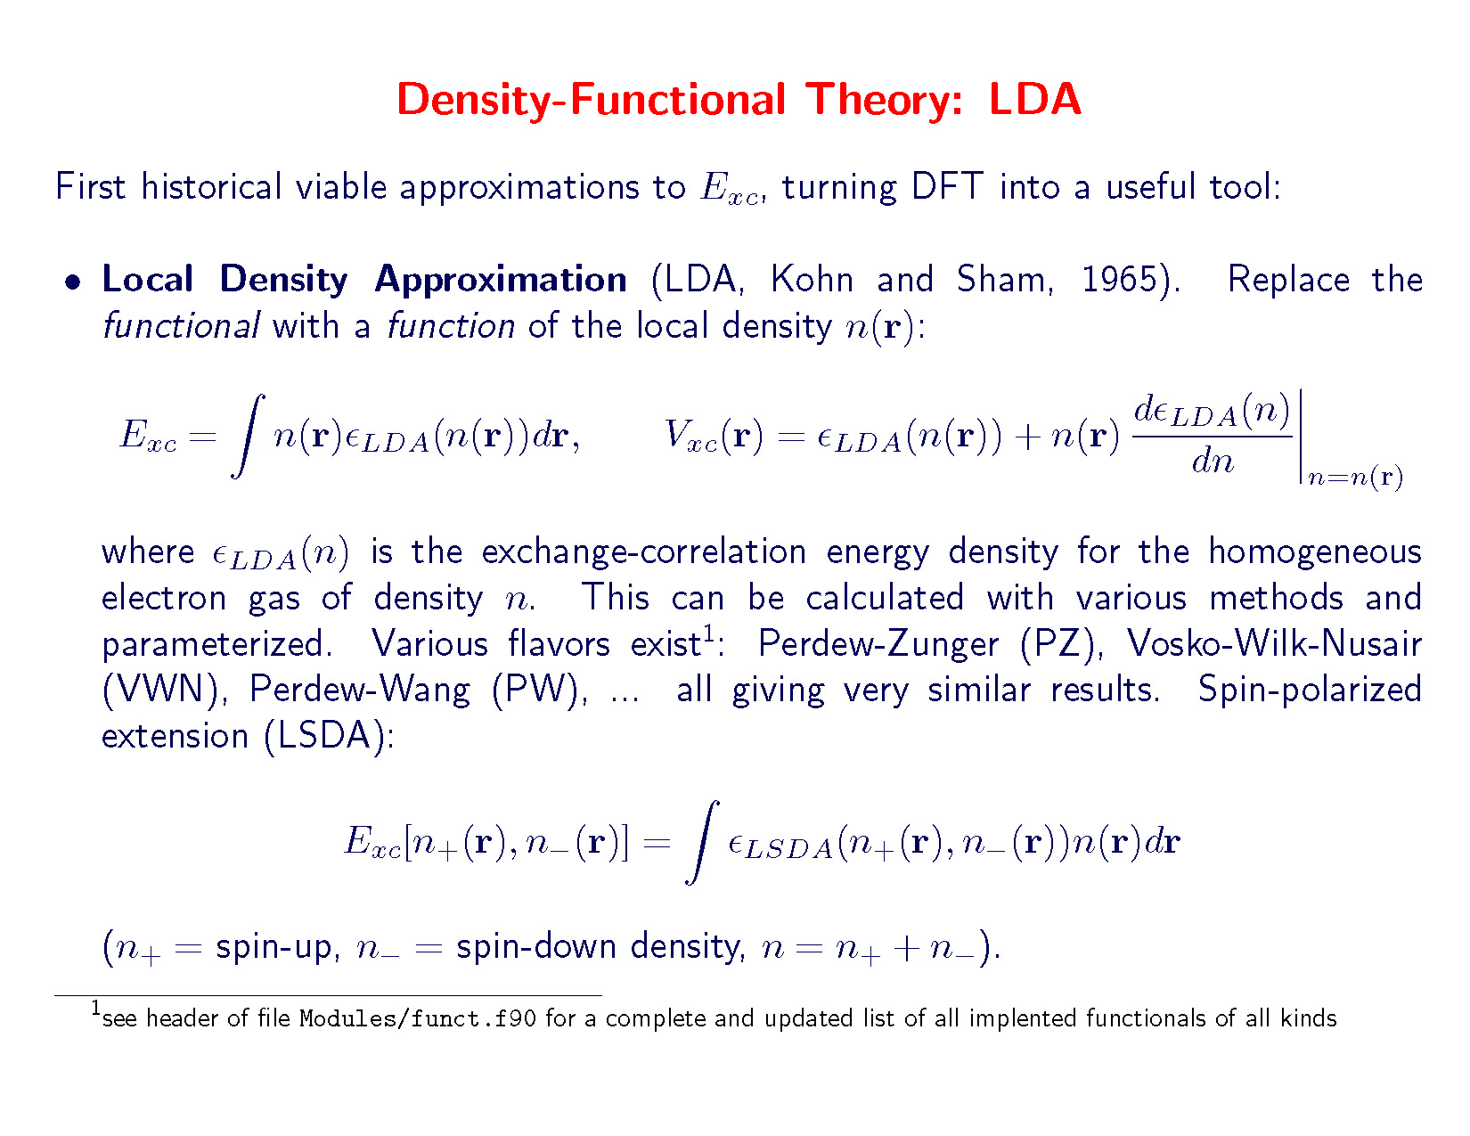

Slide 3
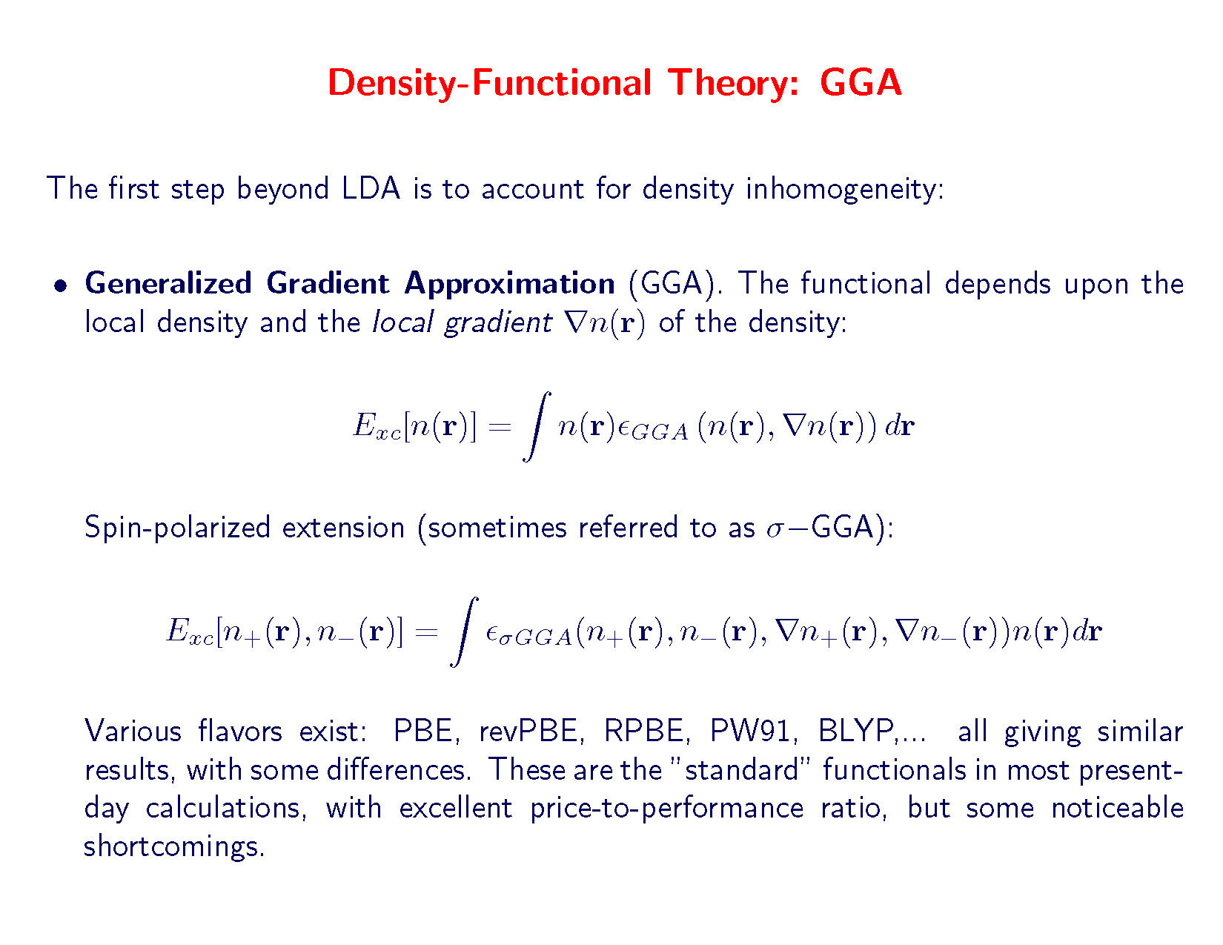

Slide 4
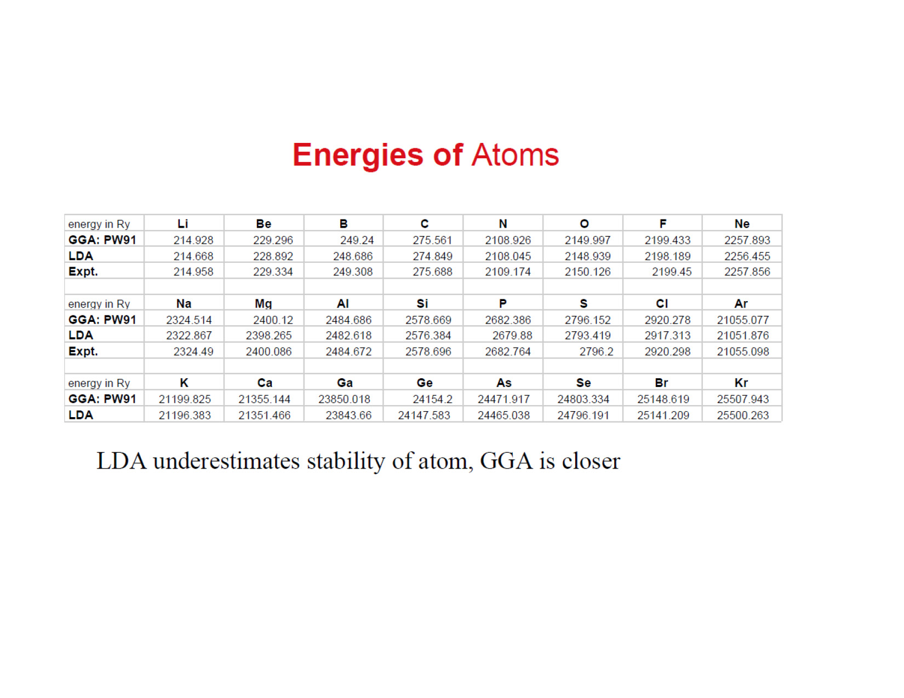

Slide 5
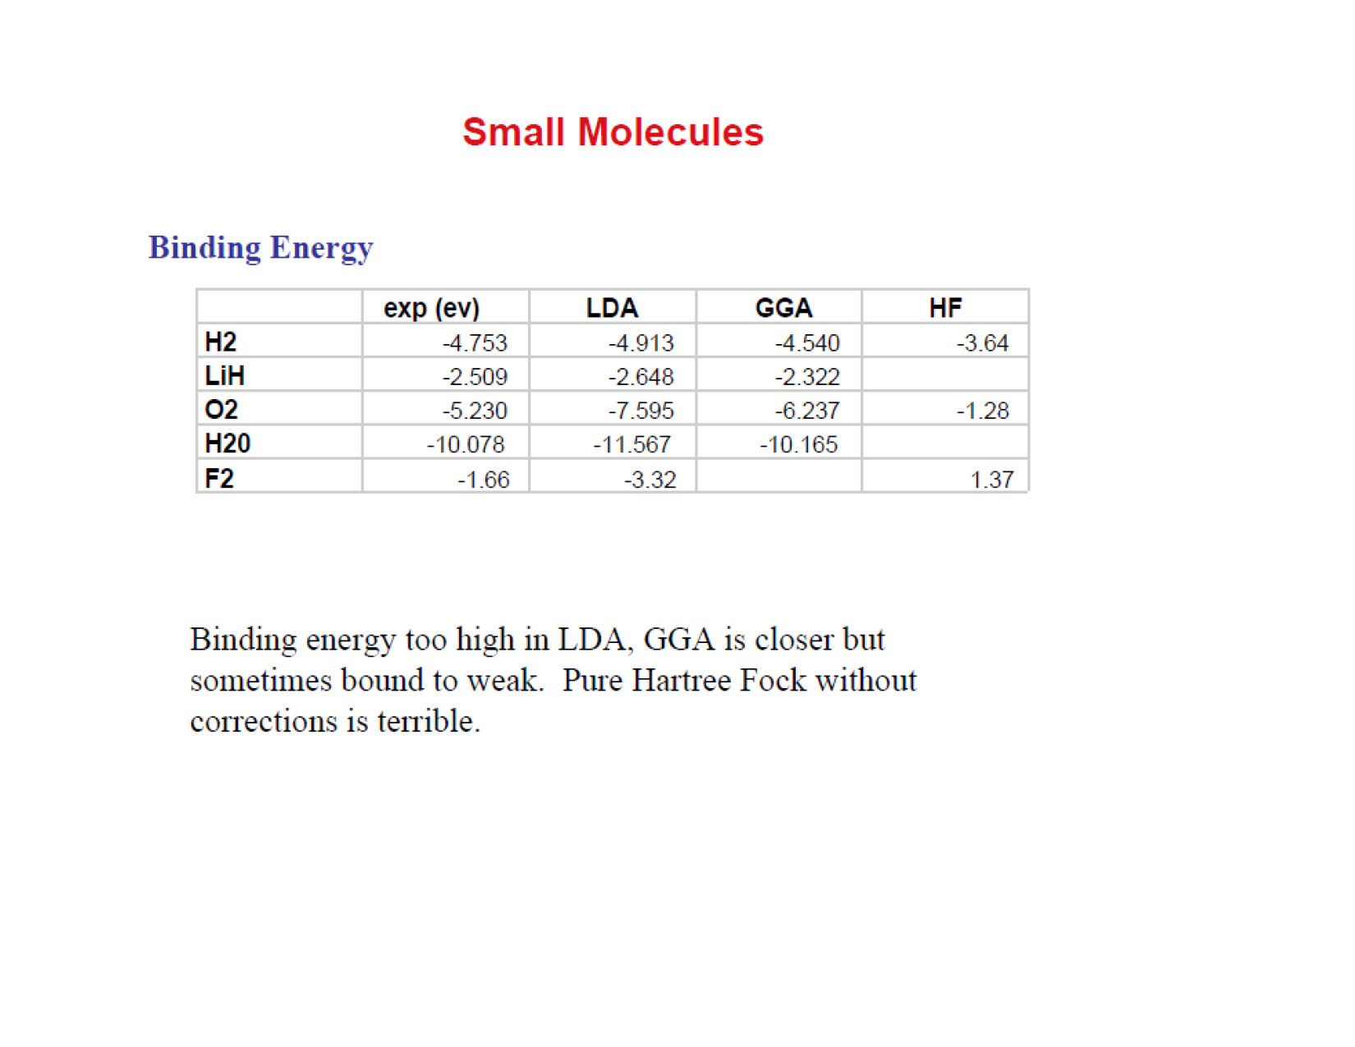

Slide 6
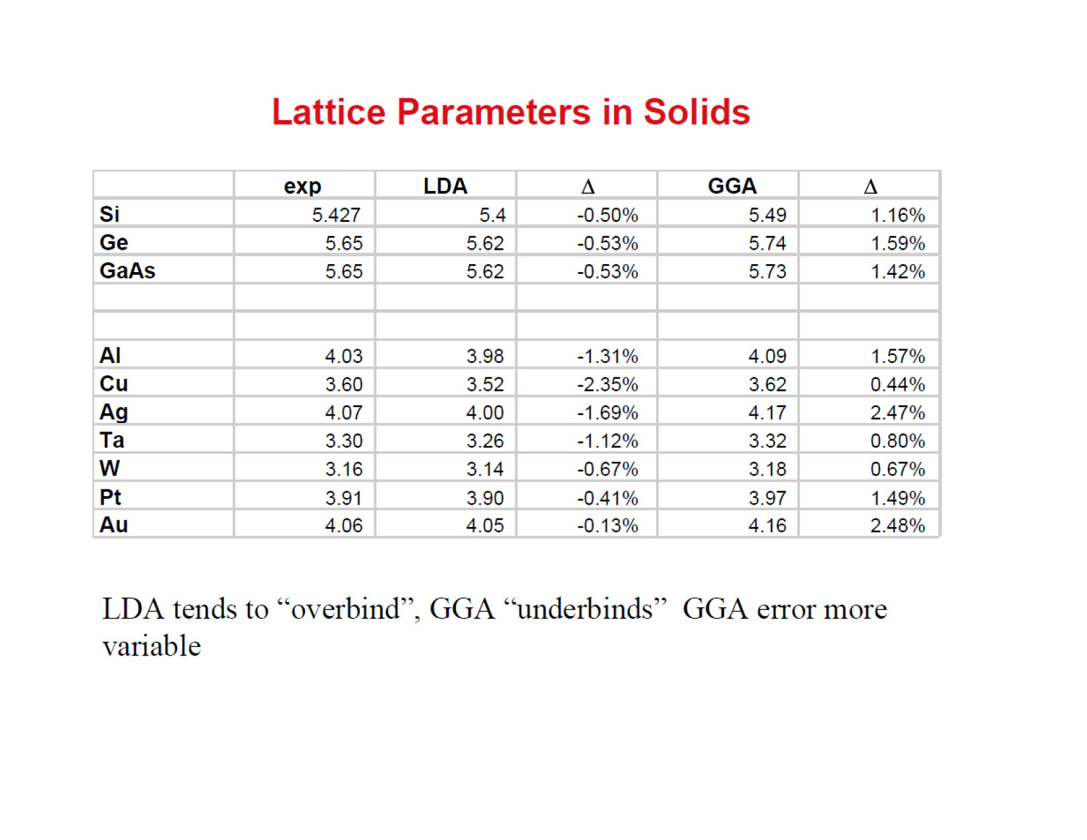

Slide 7
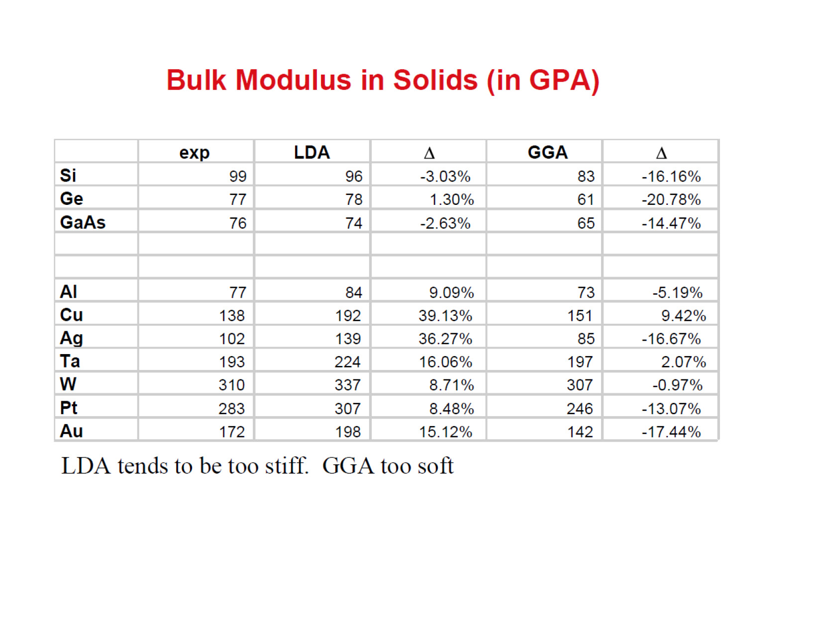

Slide 8
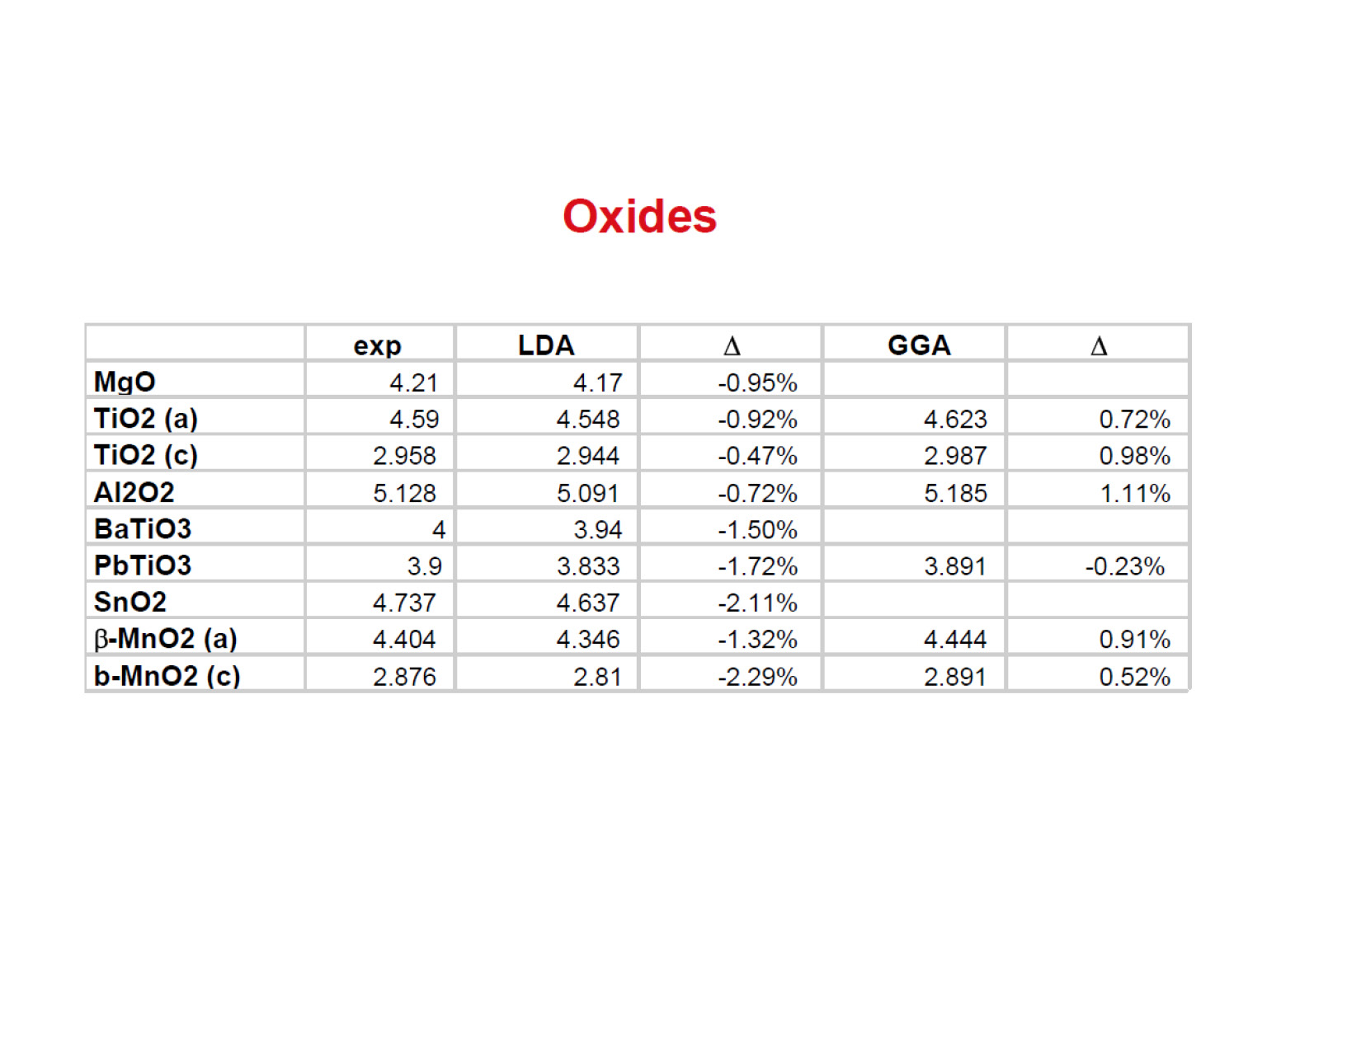

Slide 9
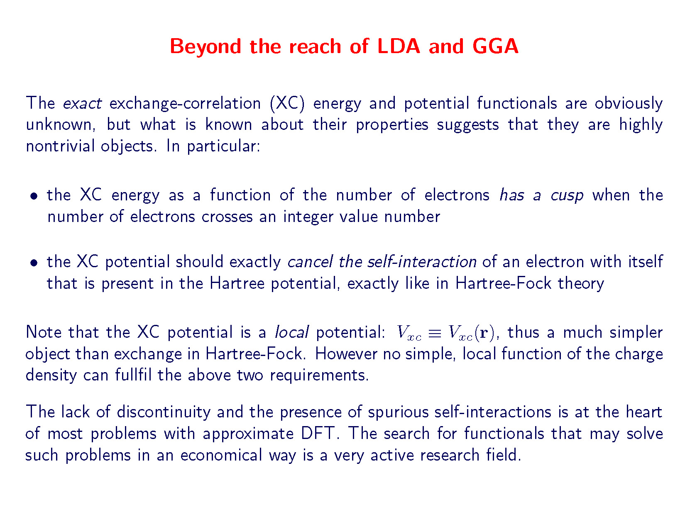

Slide 10
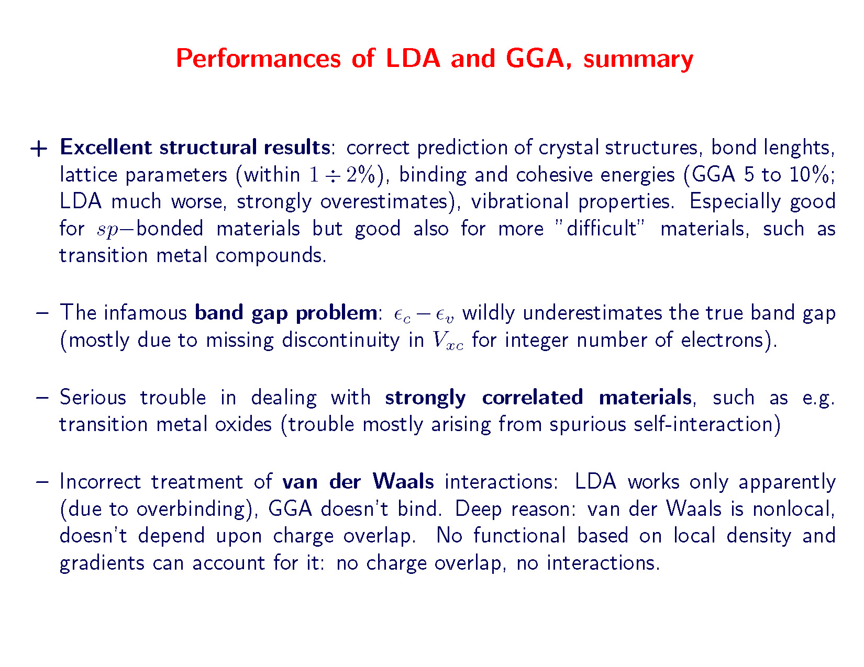

Slide 11
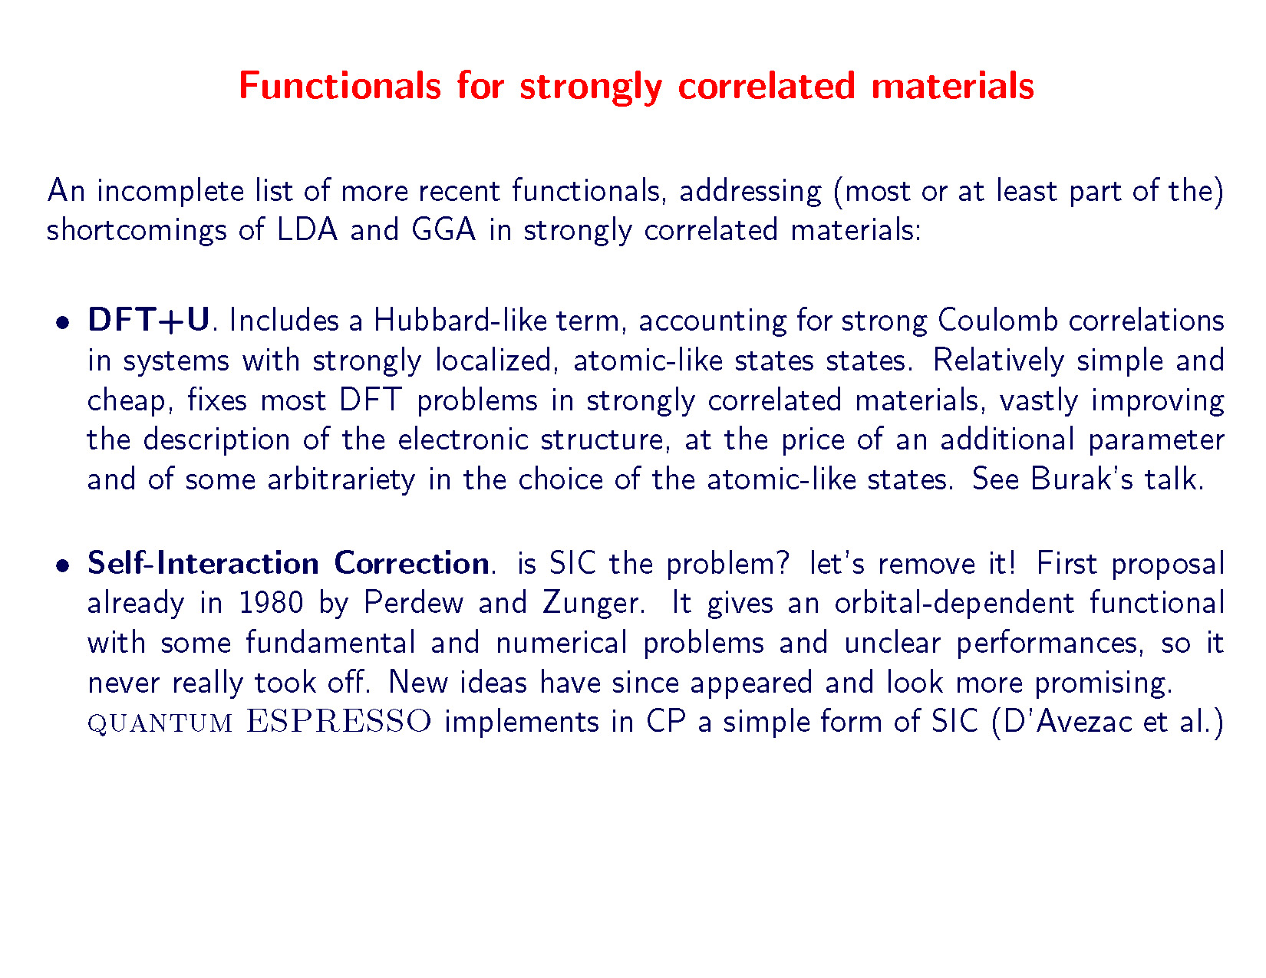

Slide 12
Need of fast and accurate HT first principles methods
Need to move beyond the current paradigm of DFT-PBE for materials description
Necessary requirement to describe successfully novel materials with strong electron localization and correlation
Develop and implement novel theoretical methodologies and computational techniques to address the challenges of the high-throughput environment by striking a balance between controllable accuracy and computational efficiency
Techniques that can simultaneously address the localized (molecular) and delocalized (solid-state) electronic structure
Volume, Variety, Velocity, Veracity

Slide 13
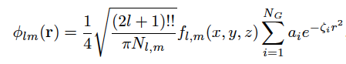
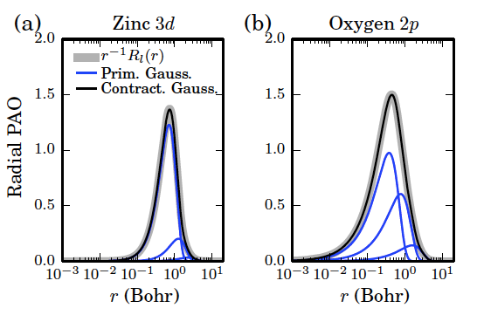
The PAO-3G basis set
The PAO basis functions can be directly fitted using linear combinations of spherical-harmonic Gaussian functions and eventually expressed as Cartesian Gaussians
Definition of a new localized basis set: PAO-3G – each PAO is fitted using three Gaussians – directly in the UPF format!

Slide 14
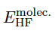
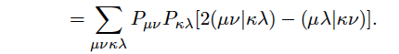
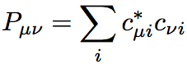
Coulomb and Exchange Integrals
Localized orbital formulation ➔ easy evaluation of two-electron integrals
Provides a simple and accurate connection between plane-waves solutions and a localized basis set of minimal dimensions
Direct calculation of Hartree-Fock energies:
Density matrix
Known from the filtering+shifting procedure
Library of PAO-3G basis functions in the
pseudopotentials UPF format
Reformulation of exact-exchange functionals

Slide 15
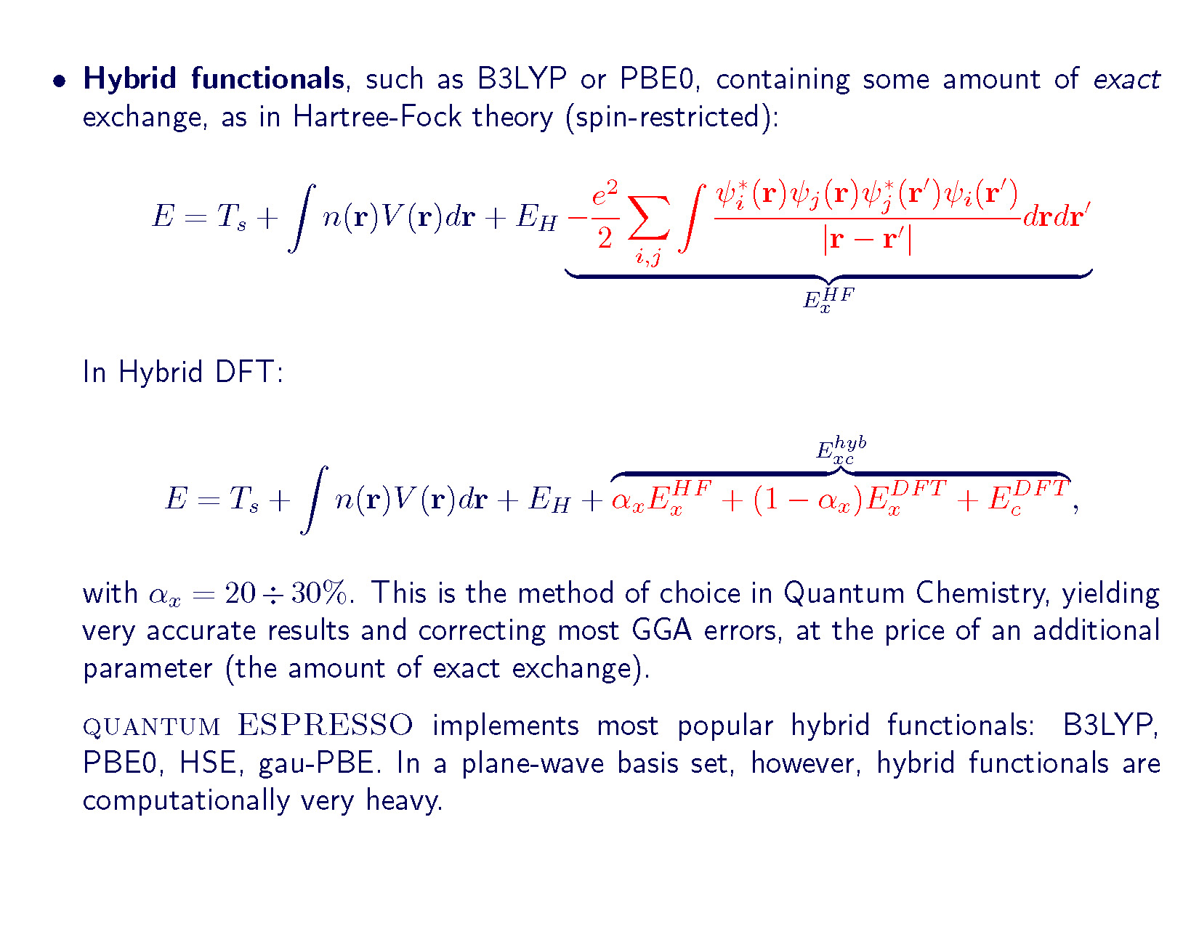

Slide 16

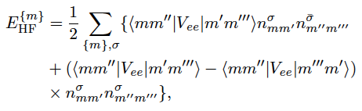
DFT+U
Use the Hubbard model to describe the most localized states of the system - correction of the mean-field delocalized nature of DFT
E_{DFT+U}=E_{DFT}+E_{U}
E_{U} form borrowed from Hartree-Fock energy – correction of the mean-field density-density electron correlation with a HF Hamiltonian
E_{DC} – double counting term that has to be subtracted from the original E_{DFT}
where

Slide 17
DFT+U
Same spirit of the exact-exchange functionals where the XC part of the functional is shaped as a Fock operator on the KS states
Important differences!
Effective interactions in DFT+U are screened and not based on the bare Coulomb interaction as in HF
DFT+U acts on a subset of states of the system: typically the localized d and f orbitals
Severe problems!
The screened Coulomb potential is not known
Ambiguity in the computation of the critical parameters
Although procedures for the ab initio computation of U and J have been proposed (cRPA, cLDA, etc.) U and J are typically used as “fitting” parameters to reproduce the correct experimental electronic structure of the system

Slide 18
DFT+U: the wish-list
The five criteria for a GOOD DFT+U functional:
W.E. Pickett, S.C. Erwin, and E.C. Ethridge, Phys. Rev. B 58, 1201 (1998)
(LDA)PBE +U, reduces to (LDA)PBE when (LDA)PBE is known to be good
the energy is given as a functional of the density
the method specifies how to obtain the local orbital in question
the definition of U and J is provided unambiguously
the method predicts antiferromagnetic insulators when appropriate and improves the description of highly correlated metals.

Slide 19
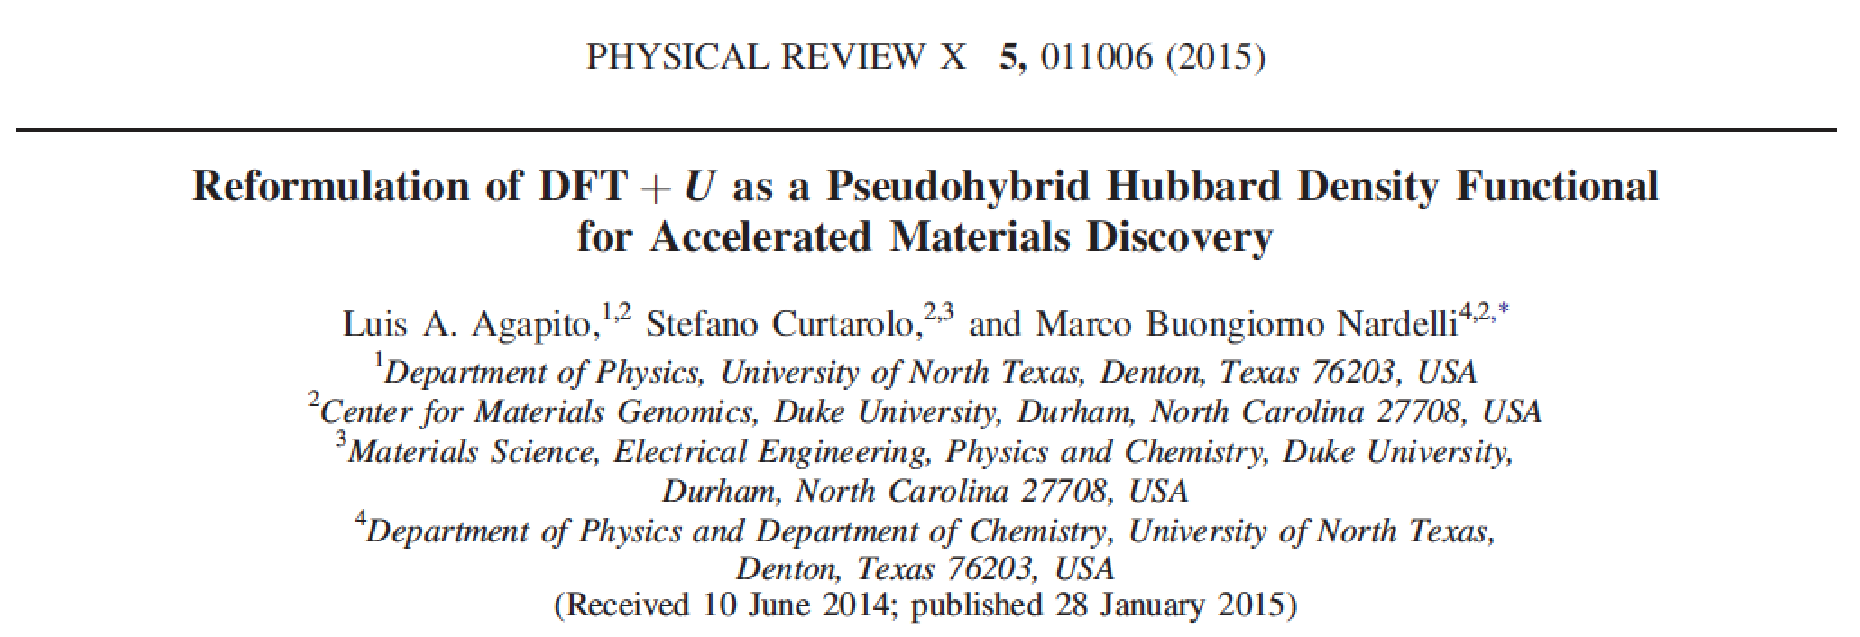
The algorithm behind
AFLOWLIB v.2: ACBN0

Slide 20
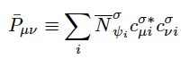
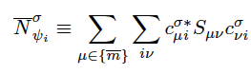
ACBN0: the ansatz
Consider the clean HF formulation with the bare Coulomb potential restricted to a single Hubbard site
The HF local energy is computed in the PAO local basis (2 electron integrals from PAO-3G) – without an explicit HF calculation!
U and J are computed directly on the chosen Hubbard center from the Coulomb and exchange Hartree-Fock energies of the solid introducing a reduced density matrix
where is the Mulliken charge of the basis of the localized orbitals,
and c_{μi} are the projections of the KS solution on the PAO basis:
effective renormalized occupations as weighting factors that specify the on-site occupation of each electronic state that comes directly from the solution of the KS Hamiltonian

Slide 21
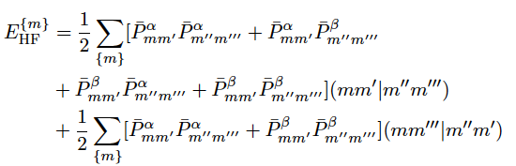
ACBN0: the ansatz
The effective on-site HF Hubbard energy is thus computed as
where the two electron integrals are restricted to the the local set of Hubbard orbitals
The on-site energy requires the computation of a small number of electron-repulsion integrals, namely only those involving the {m} set (i.e. 5⁴ integrals for the d shell)
The PAO-3G projection scheme allows the calculation of E_{HF} for periodic solids via a simple generalization (no cluster or finite size calculations)
P_{mm’} carries all the information of the electronic structure
of the system from which it is derived

Slide 22
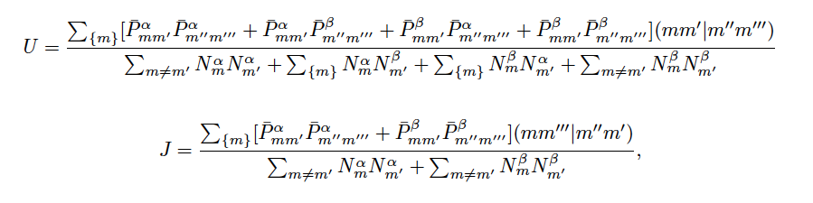
ACBN0: the ansatz
From the direct comparison with the original Anisimov formula we derive the expression for U and J in the general case of a spin-polarized system
P_{mm’} depends on the electron density, since it is derived from the PAO-3G projection scheme
IT IS A TRUE DENSITY FUNCTIONAL
See also related works from A. Andriotis et al., PRB 2010 and E. Carter et al., J. Chem. Phys., 2008

Slide 23
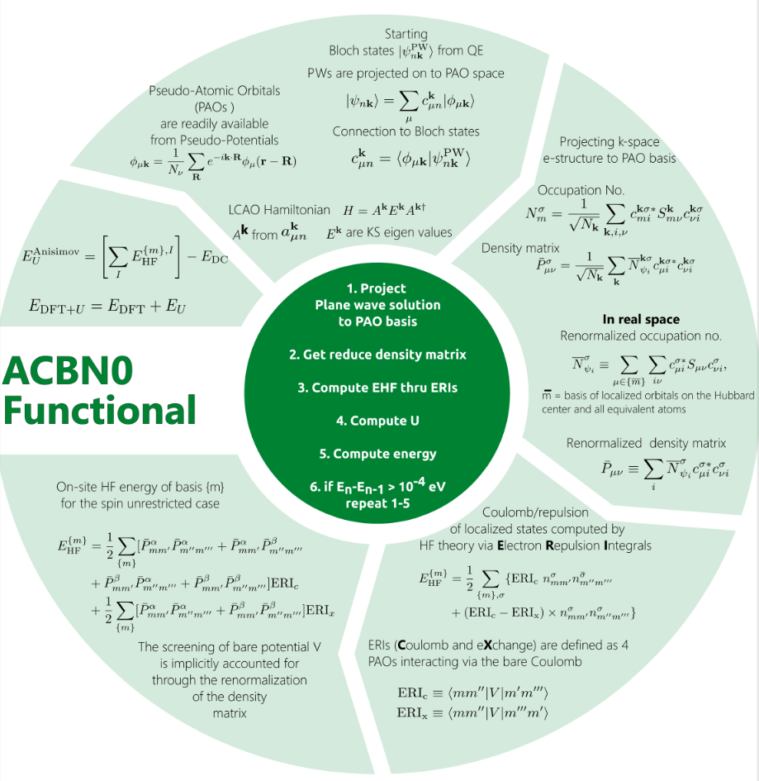
ACBN0: the algorithm
Simplified self consistent scheme for the solution of the KS-ACBN0 equations:
Initial U=0
First effective U from ACBN0
Back as a DFT+U calculation
Iterate until U (and total energy) are converged
Completely integrated in the AFLOW-𝞹 framework
ACBN0

Slide 24
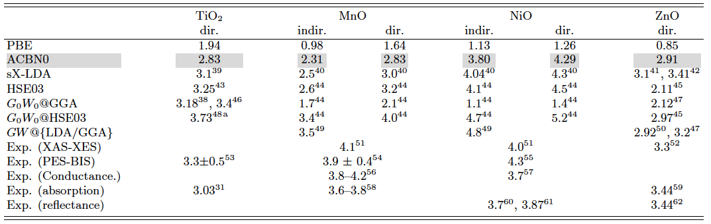
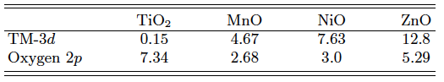
Transition Metal Oxides
Wide range of 3d shell fillings 3d² , 3d⁵ , 3d⁸ , and 3d¹⁰ in Ti, Mn, Ni and Zn
Substantial correction wrt the PBE values
U and J calculated for both TM and oxygen – U_{O} not negligible and essential for the correct representation of the electronic structure

Slide 25
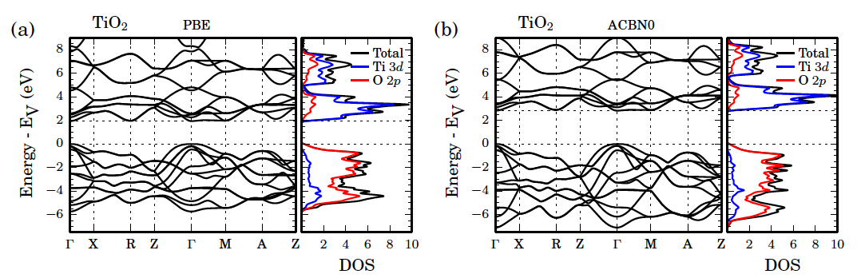
TMOs: TiO₂
Converged values for the rutile environment are Ti U_{3d}= 0.15 eV and O U_{2p}= 7.34 eV
Focus on oxygen – potential implication for proper description of O vacancies in TiO₂
Band gap increases from 1.98 eV (PBE) to 2.83 eV (ACBN0) vs. an experimental value around 3.3 ± 0.5 eV
Band width in agreement with many-body GW calculations

Slide 26
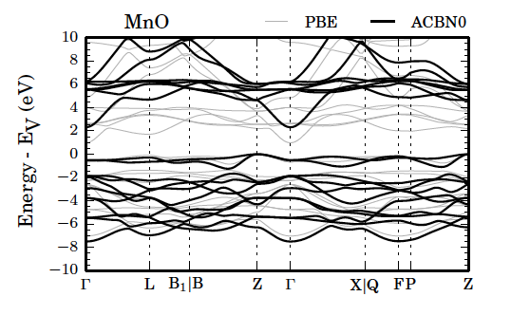
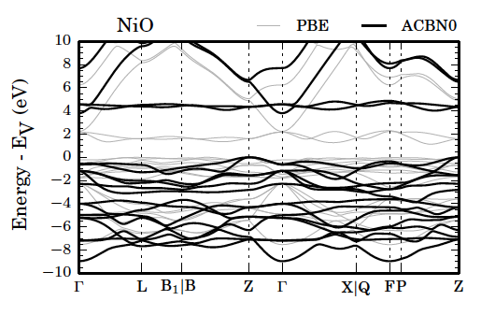
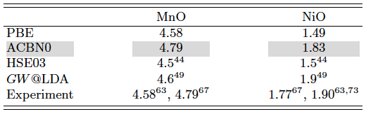
Magnetic TMOs: MnO and NiO
Increase of the bandwidth of the occupied manifold, in agreement with experiments and many-body (GW) calculations
Increase of the t_{2g} bonding-antibonding splitting across the bandgap and indirectly the separation of the 4s parabolic band (correction of the position of the conduction d bands in NiO!)
Increase of the band-gap (direct and indirect) and of the band-width
Excellent agreement for the total magnetization

Slide 27
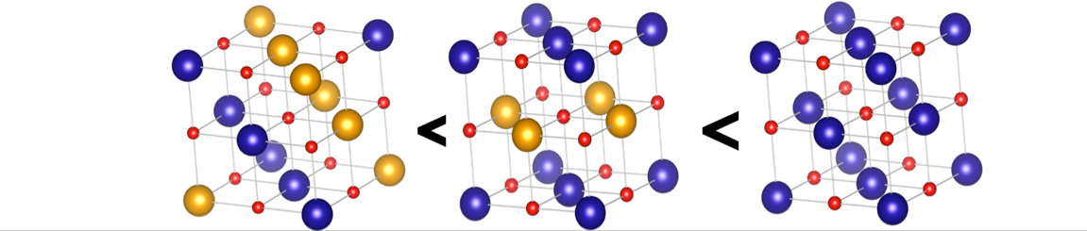
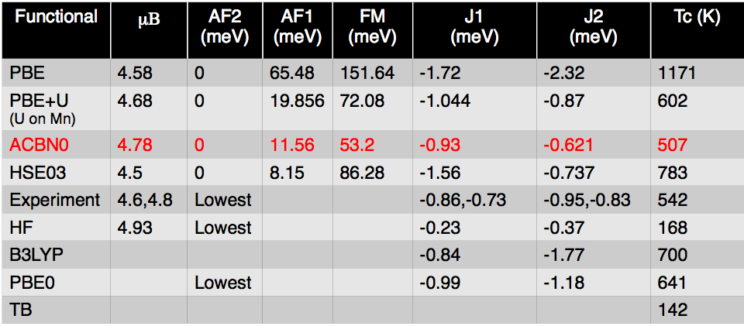
Magnetic TMOs: magnetic ordering in MnO
ACBN0 correctly predicts the stability of the antiferromagnetic insulator state of TMOs when appropriate
ACBN0 correctly predicts the stability of the antiferromagnetic insulator state of TMOs when appropriate

Slide 28
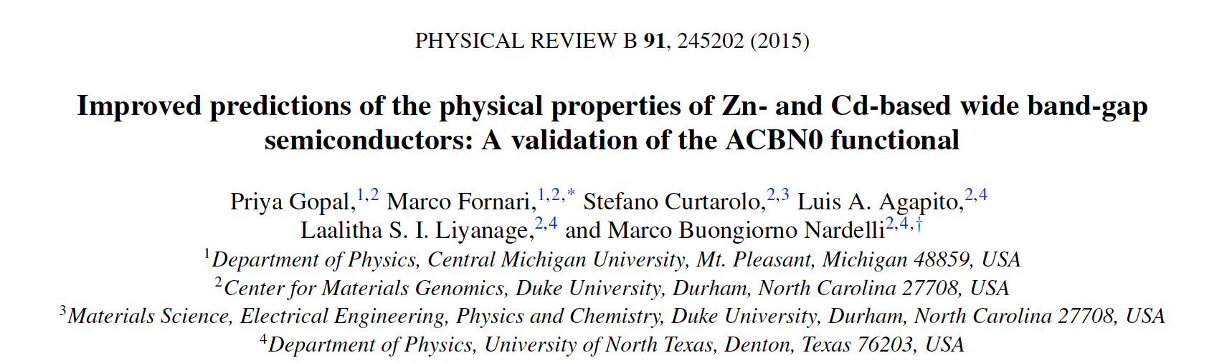
Novel HT- enabling tools for accelerated materials replacement
Validation of the ACBN0 functional:
Zn and Cd oxichalcogenides
28

Slide 29
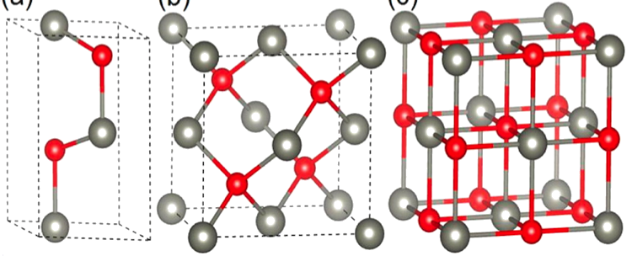
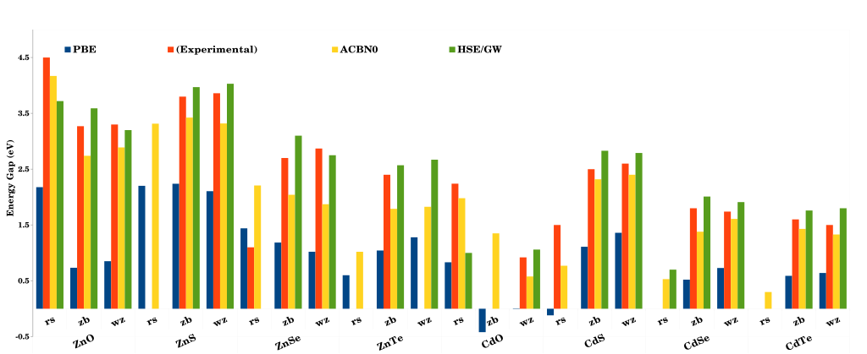
ZnX and CdX oxides and chalcogenides (X=O,S,Se,Te) - electronic properties
wz
zb
rs

Slide 30
Validation of ACBN0
Accurate but
prohibitively
expensive
AFLOWLIB v.2
AFLOWLIB v.1,
Materials Project.
AiiDA…
Accuracy comparable with EXX functionals
and many-body calculations!!
30

Slide 31
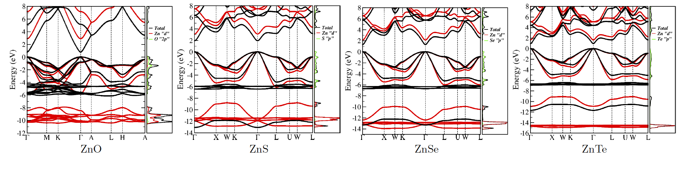
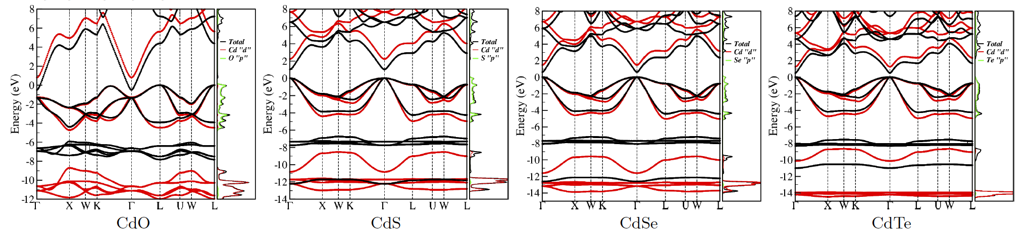
Band structures
31

Slide 32
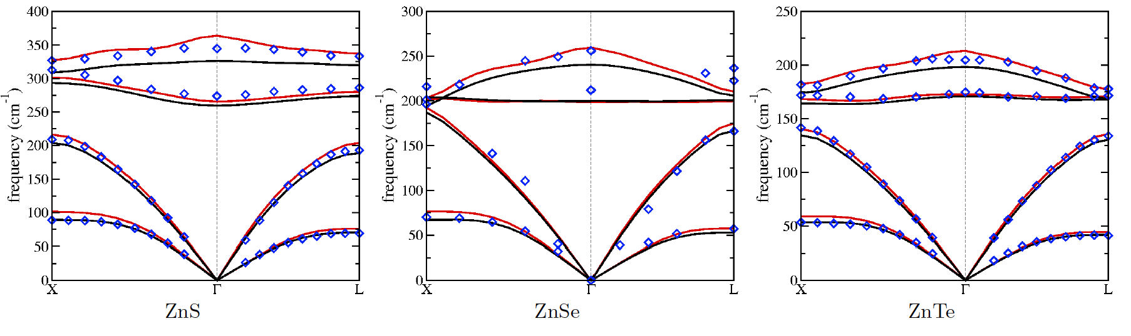
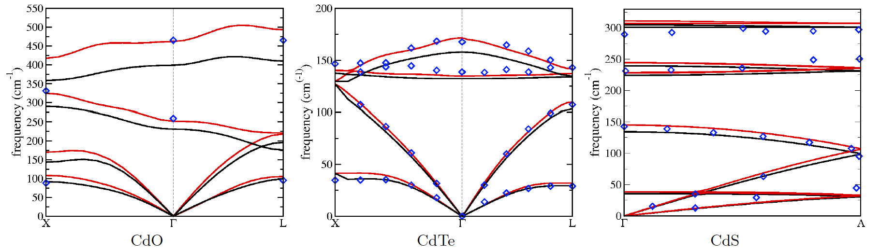
Phonon dispersions
32

Slide 33
ZnO – Theoretical Spectroscopy
PBE
ACBN0
Improvement is the electronic structure translates in improvement of other properties as well
Excellent agreement of phonon dispersion with experiments – thermal properties
FD subpackage in Phonon developed at UNT
Finite differences and finite fields
33

Slide 34
ZnO – Theoretical Spectroscopy
experiment
theory (FF/FD)
T. Sander et. al. PRB 85, 165208 (2012)
34

Slide 35
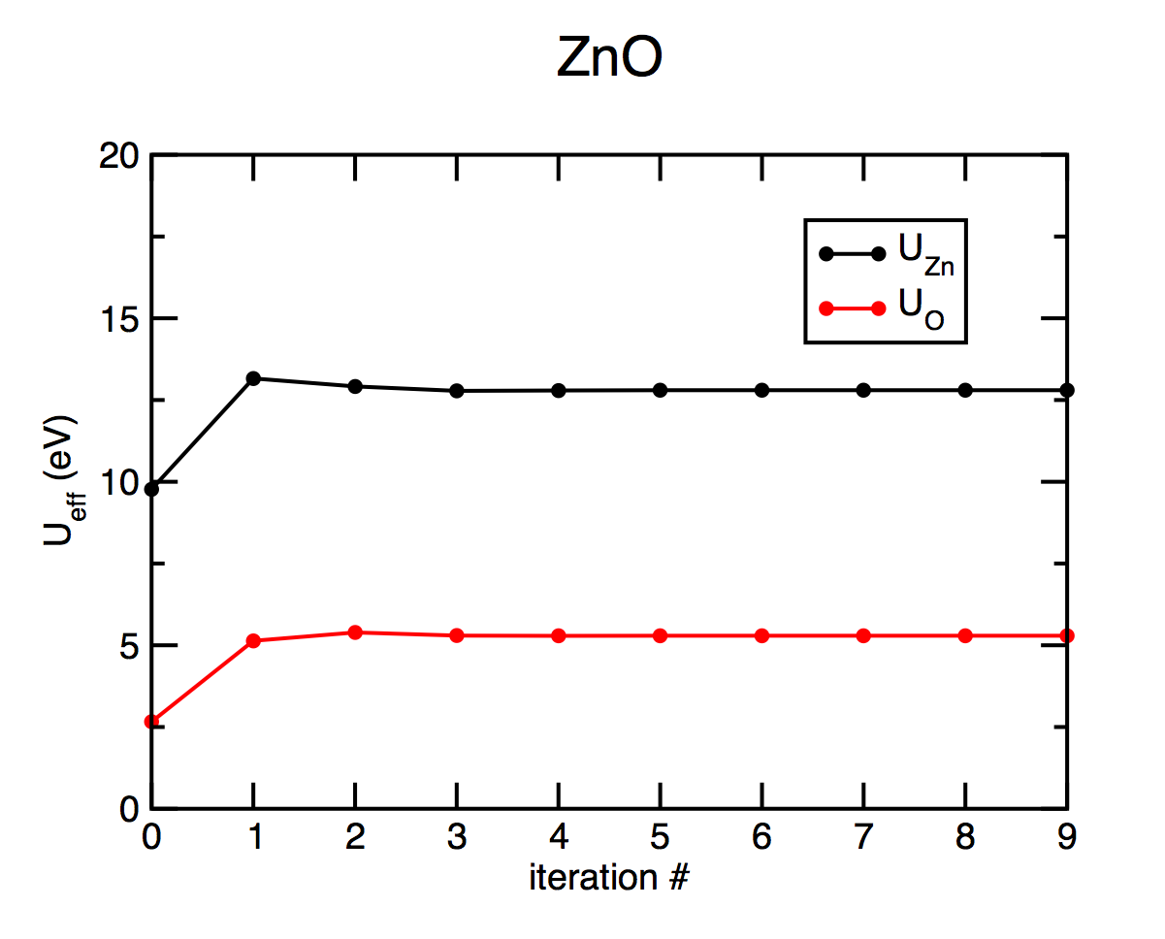
Convergence of U_{eff}
Excellent convergence in less that 5 iterations

Slide 36
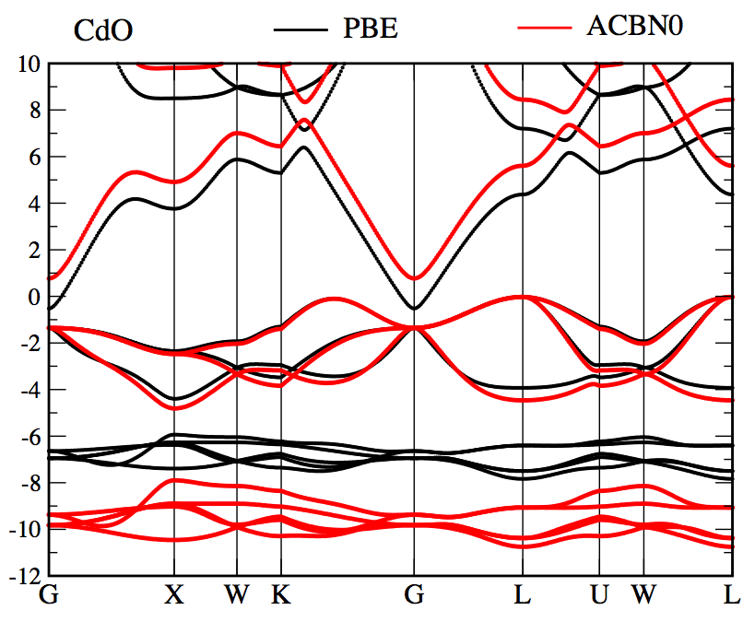
CdO - band structure
Within PBE, the system is a metal (indirect gap)
Cd U_{3d}=11.3 eV and O U_{2p}=3.9 eV give a direct band-gap of 1.98 eV (exp. 2.24 eV)
Good agreement with experiments for both the band gap and the position and width of the d bands

Slide 37
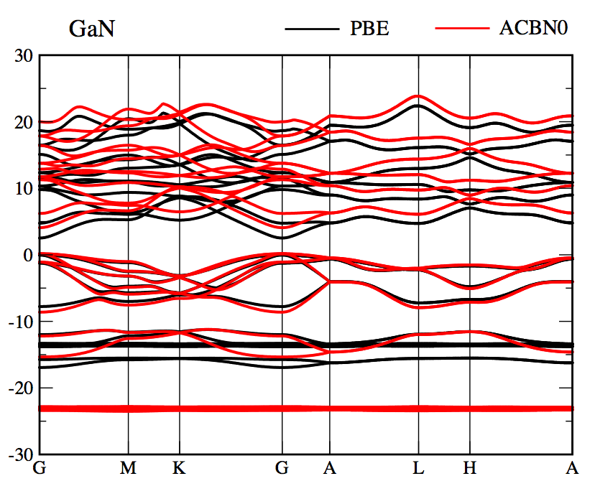
GaN
Ga U_{3d}=23.5 eV (full core d shell – atomic limit) and N U_{2p}=4.2 eV give a band-gap of 3.8 eV slightly higher than experimental results (3.4 eV) - same as HSE
The high U value on Ga d affects only the position of the core levels and not the valence band behavior
In general, hybridization in semiconductor is important – sp, pd cross U terms

Slide 38
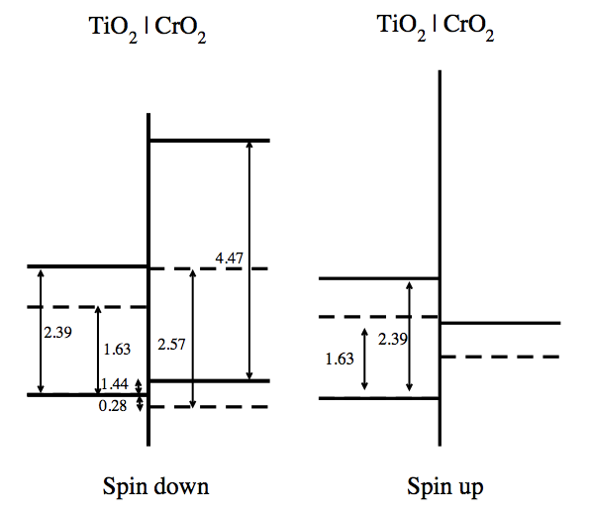
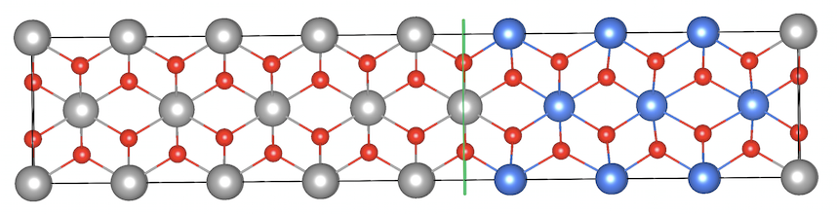
Interfaces
Variation of U across the interface – influence on the band alignment

Slide 39

ACBN0: the check-list
Back to the five criteria for a GOOD DFT+U functional:
(LDA)PBE +U, reduces to (LDA)PBE when (LDA)PBE is known to be good
When the localized bands are not readily disentangled from other bands or when the orbitals are not thoroughly well localized. In the latter case, the method yields proportionally lower values of U – for instance Si 2p states yield a value close to zero

Slide 40
ACBN0: the check-list
Back to the five criteria for a GOOD DFT+U functional:
(LDA)PBE +U, reduces to (LDA)PBE when (LDA)PBE is known to be good
the energy is given as a functional of the density
The value of U in ACBN0 depends only on the electron density. The ACBN0 functional can be considered a zero^{th}-order pseudo-hybrid density functional in the sense that it includes an on-site form of the Hartree-Fock exchange

Slide 41
ACBN0: the check-list
Back to the five criteria for a GOOD DFT+U functional:
(LDA)PBE +U, reduces to (LDA)PBE when (LDA)PBE is known to be good
the energy is given as a functional of the density
the method specifies how to obtain the local orbital in question
As seen above, there is no need to specify any orbital explicitly: even though the information of the expansion coefficients is conceptually included in the renormalized density matrix, they are not individually resolved.

Slide 42
ACBN0: the check-list
Back to the five criteria for a GOOD DFT+U functional:
(LDA)PBE +U, reduces to (LDA)PBE when (LDA)PBE is known to be good
the energy is given as a functional of the density
the method specifies how to obtain the local orbital in question
the definition of U and J is provided unambiguously

Slide 43
ACBN0: the check-list
Back to the five criteria for a GOOD DFT+U functional:
(LDA)PBE +U, reduces to (LDA)PBE when (LDA)PBE is known to be good
the energy is given as a functional of the density
the method specifies how to obtain the local orbital in question
the definition of U and J is provided unambiguously
the method predicts antiferromagnetic insulators when appropriate (and improves the description of highly correlated metals – in the works!!!).

Slide 44

ACBN0: the check-list
All this at (almost) the price of a regular PBE+U calculation!!!

